Slide 1
The Songdb
Emmet Mc Eneaney
Thomas Conroy
Tadas Gverzdys

Slide 2
iNTROduction
Our website is a social media site where you can chat with friends, express your thoughts AND browse the latest and greatest that the world of music has to offer!

Slide 3
functionality
Add Friends
Send Messages
Post Statuses
Search Songs
Learn About Music Artists
Administrator Functionality

Slide 4
Data management
Five Databases –
Users
Friends
Friend Requests
Messages
Statuses

Slide 5
User experience
Found Bootstrap file to use but altered a lot of it.
Use of API – Last/fm API bringing together a social media site and a music lover’s experience
Use of Javascript - Detects whether or not a user is an administrator or just not to restrict features

Slide 6
security
Hashing passwords
Encrypting messages
Salting passwords
Admin features for admins only

Slide 7
Validation
Client-side validation
Registration form – “type = email”, etc
Why? Simple but very effective

Slide 8
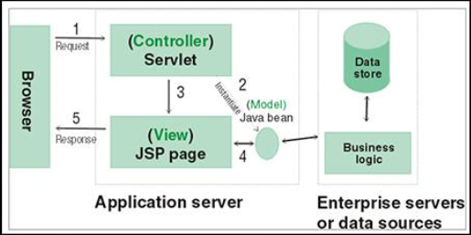
Code design & system architecture

Slide 9
Testing
Junit tests
Number of User Tests
Continuous functionality tests

Slide 10
Research-based features (extras)
Last.fm API
Salting passwords
Encrypting/decrypting messages

Slide 11
Process management & organisation
“What’s next” approach
Started off looking at each other's strengths
Task list built itself

Slide 12
Task ALLOCATION & PLANNING
Our approach was simple but effective – Play To Strengths
Mostly Voluntary
As project went on, tasks got harder to assign

Slide 13
Emmet’s Contribution
Physical Database system
Friends functionality
Friend requesting system
Some Administrator features
Some of the individual page layouts

Slide 14
Thomas’ Contribution

Slide 15
Tadas’ Contribution

